Slide 1

www.olms.dol.gov
LM-1 Electronic Form
Requirements Review
July 30, 2019
OLMS – EFS LM 1

Slide 2
www.olms.dol.gov
OVERVIEW
User Registration Process
Union Registration – Temporary Registration ID and PIN
Required Fields
Signature and Submission process
Approval process
Disclosure
Questions
OLMS – EFS LM 1

Slide 3
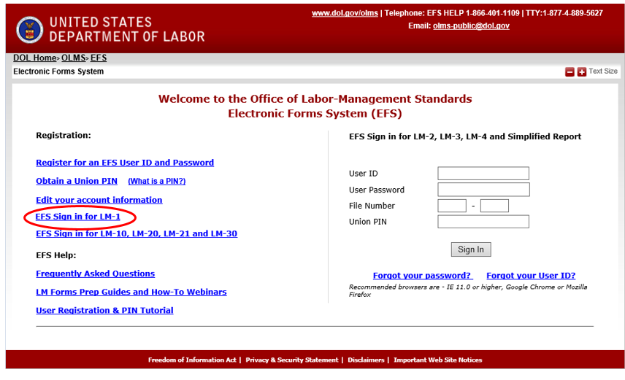
www.olms.dol.gov
User/filer Registration
Filer/Preparer will register for an EFS account.
OLMS - EFS LM 1
A link will be added to the EFS Home page to access LM-1.

Slide 4
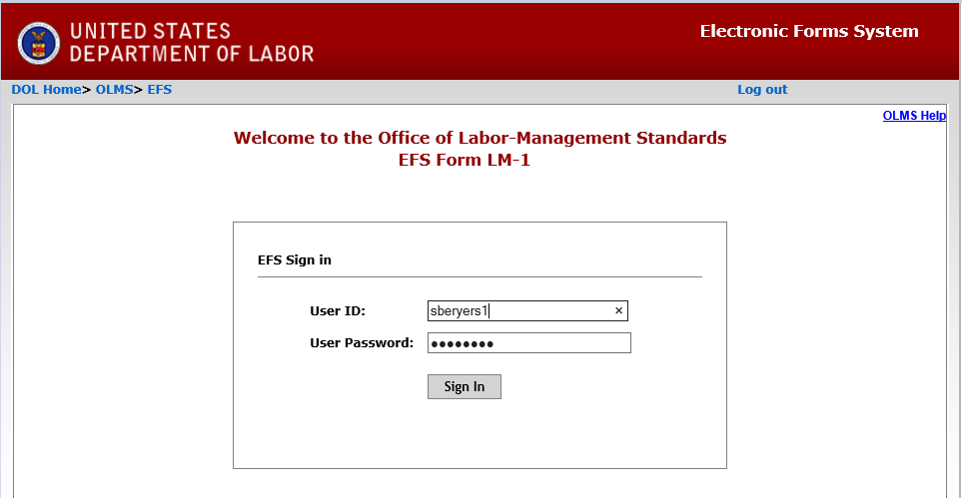
www.olms.dol.gov
Login
Filer will login using the new/existing EFS user account.
OLMS - EFS LM 1

Slide 5
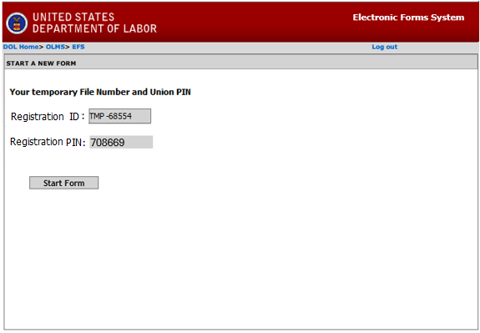
www.olms.dol.gov
Registration ID and union PIN
The system will generate a Registration ID and PIN.
OLMS - EFS LM 1
The filer who initiates the LM-1 form will receive an email listing this registration ID and PIN.
The union officers will share this registration ID and PIN to access their LM-1 in progress, to complete the form and to sign/submit the form.

Slide 6
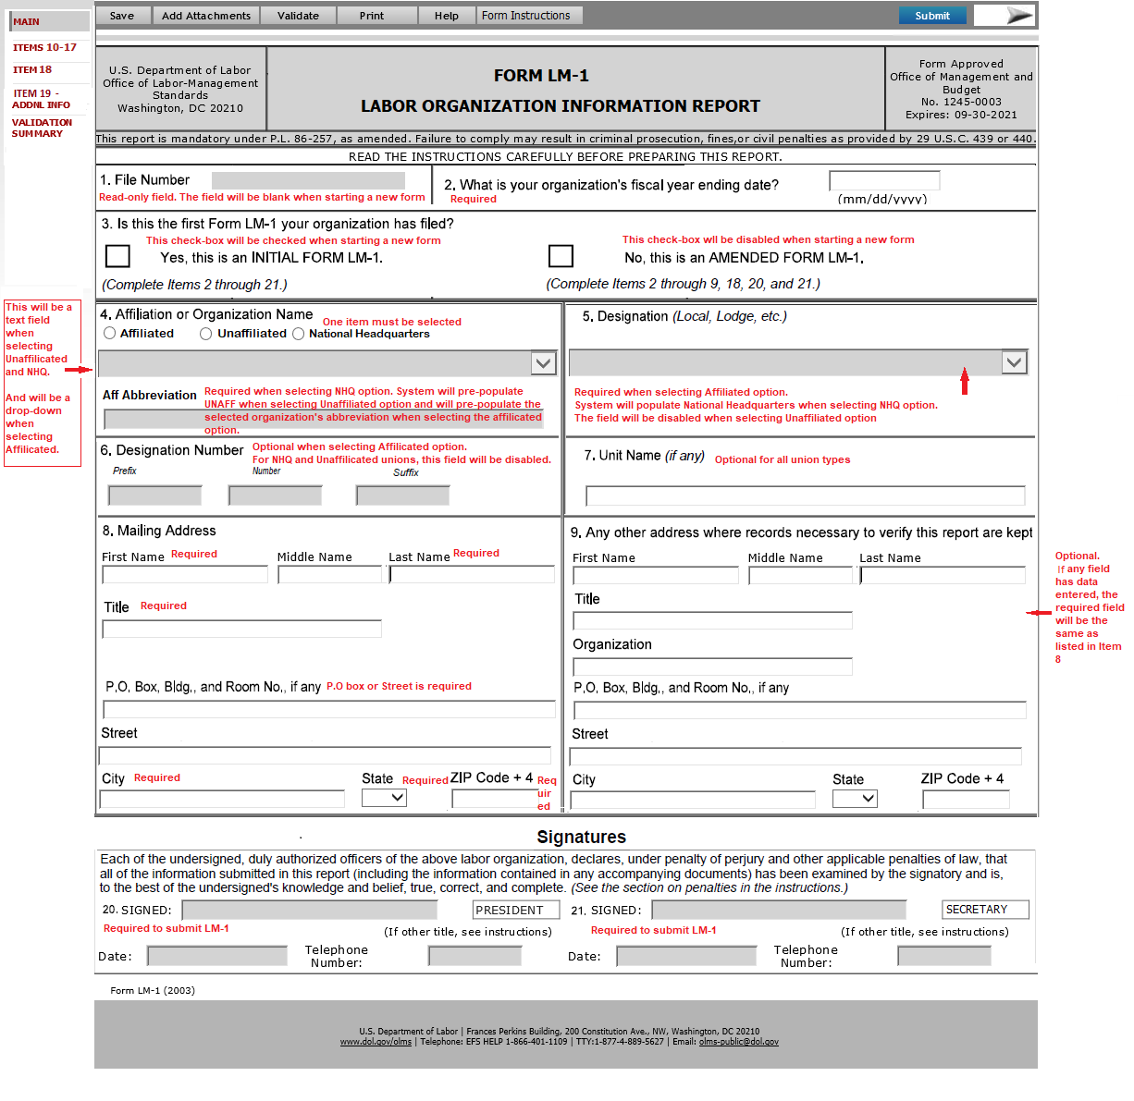
www.olms.dol.gov
Page 1
OLMS - EFS LM 1

Slide 7
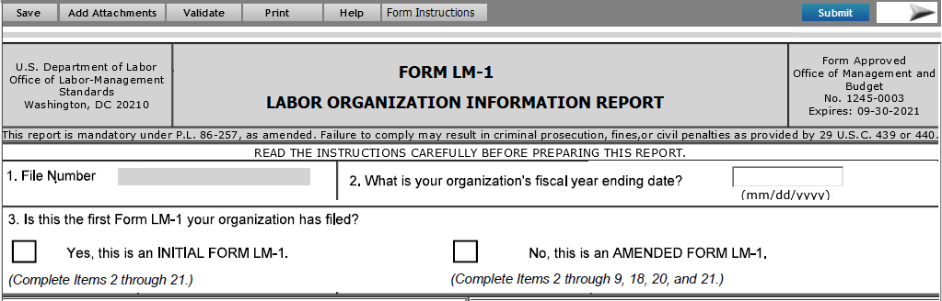
www.olms.dol.gov
Page 1 – cont.
OLMS - EFS LM 1
Item 1 and 2
Item 1 – This field will be blank for a new LM-1.
Amended LM-1 will display the file number.
Item 2 - This will be a date field. The format for the field should be MM/DD/YYYY. The date cannot be a future date.
Item 3
INITIAL FORM LM-1 – This will be checked by the system when starting a new form and will remain as read-only field.
AMENDED FORM LM-1 – This will be checked by the system when amending a submitted form and will remain as read-only field.

Slide 8
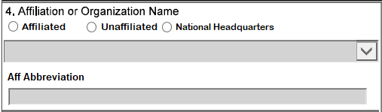
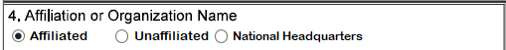
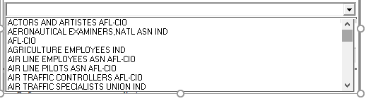
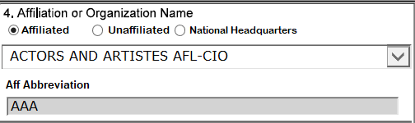

www.olms.dol.gov
Page 1– cont.
Item 4 – Affiliation or Organization Name
The filer will select one of the following options first.
Affiliated, Unaffiliated and National Headquarters.
Allowed to select only one option.
If the Affiliated option is selected:
OLMS - EFS LM 1
Item 4 – Affiliation or Organization will be enabled as a drop-down list.
The system will list all existing unions (Affiliation/Organization name and the abbreviation) in the drop-down list.
Aff Abbreviation – Once an organization is selected,
The abbreviation for the selected union will automatically get populated in this field.
Not allowed to modify the abbreviation

Slide 9
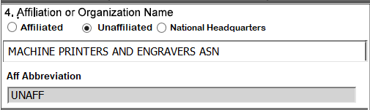
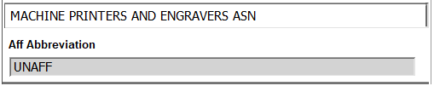
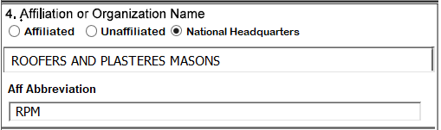
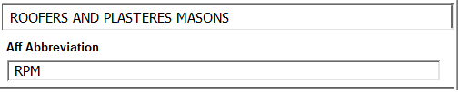
www.olms.dol.gov
Page 1– cont.
Item 4 - Affiliation or Organization Name
If the Unaffiliated option is selected:
Item 4 will be enabled as a text field to type the name of the organization.
Aff Abbreviation – the system will populate UNAFF in this field.
This abbreviation cannot be modified.
OLMS - EFS LM 1
If the National Headquarters option is selected:
Item 4 will be enabled as a text field to type the name of the organization.
Aff Abbreviation – this field will be enabled to type the union’s abbreviation.
Not allowed to enter an integer in this field.
Not allowed to use an existing abbreviation.

Slide 10
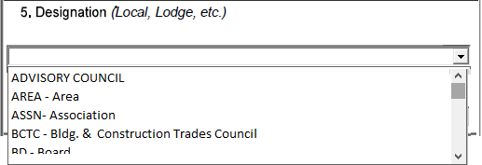
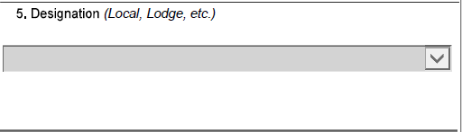
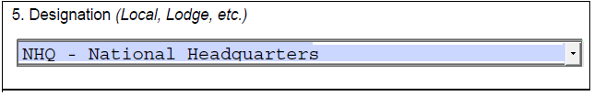
www.olms.dol.gov
Page 1
Item 5 – Designation (Local, Lodge, etc.)
If the Affiliated option is selected in Item 4,
The Item 5 Designation will be enabled as a drop-down list.
All existing designations will be listed in this drop-down list.
The filer may pick any designation from the list.
OLMS - EFS LM 1
If the Unaffiliated option is selected in Item 4,
Item 5 Designation will be disabled for the data entry.
If the National Headquarters option is selected in Item 4,
The Item 5 Designation, the system will populate NHQ - National Headquarters automatically and will remain read-only.

Slide 11


www.olms.dol.gov
Page 1– cont.
Item 6 – Designation Number
If the Affiliated option is selected in Item 4,
Item 6 Designation Number will be enabled for data entry.
Prefix – This will be a text field to enter the designation prefix.
Number – This will be an integer field to enter the designation number.
Suffix – This will be a text field to enter the designation suffix.
OLMS - EFS LM 1
If the Unaffiliated or the National Headquarters is selected in Item 4,
The Item 6 Designation Number will be disabled for the data entry.

Slide 12
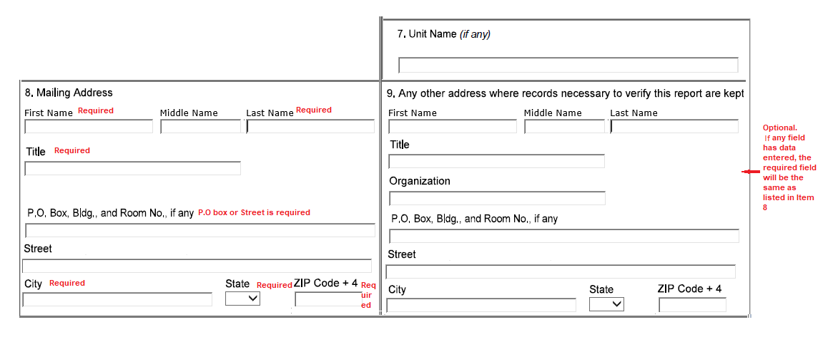
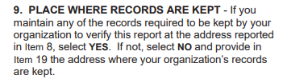
www.olms.dol.gov
Page 1– cont.
Items 7, 8 and 9
OLMS - EFS LM 1
Item 7 will be enabled for all union types and will be an optional field.
Item 8 will be required for all union types.
Item 9 will be optional for all union types.
However, if data entered in any field in Item 9, the required fields will be the same as listed Item 8
The instructions for Item 9 are not matching with the current PDF.

Slide 13
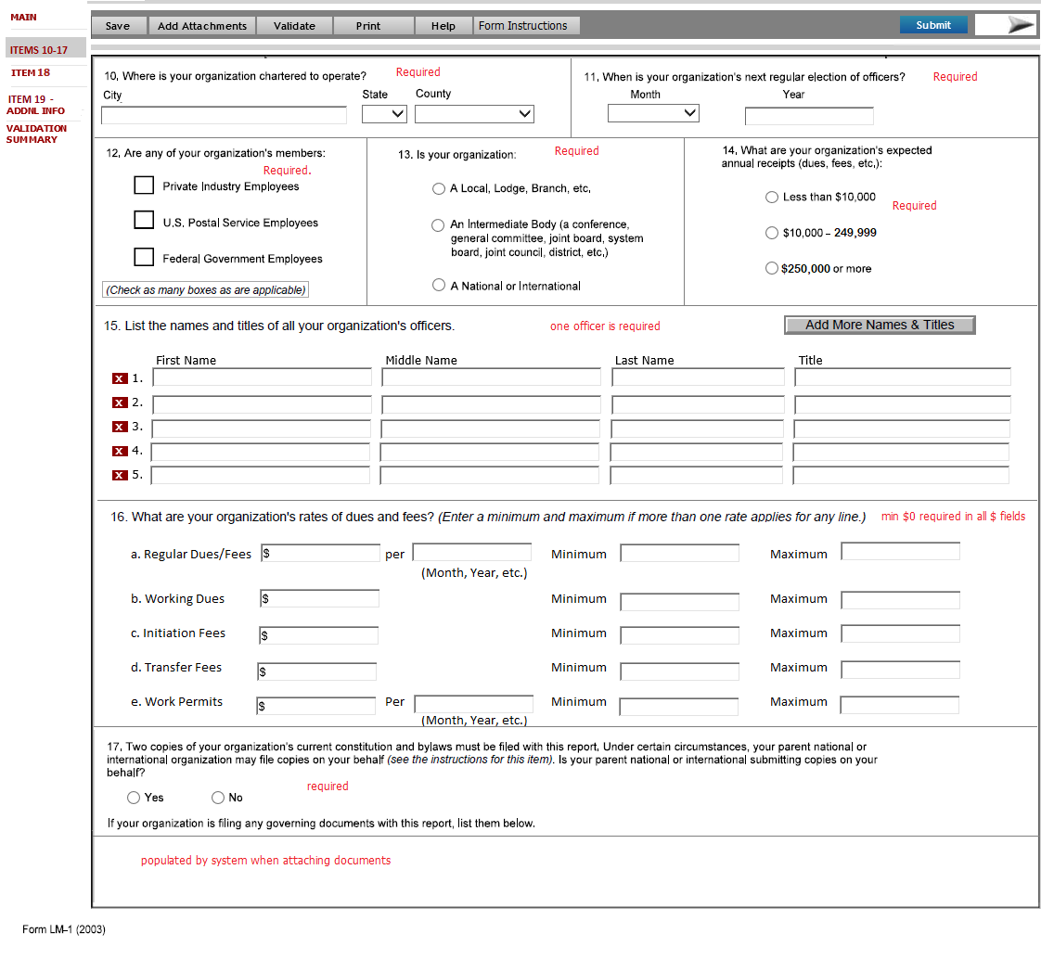
www.olms.dol.gov
Page 2
Items 10-17 listed in this page.
OLMS - EFS LM 1

Slide 14
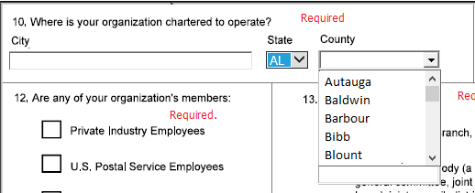
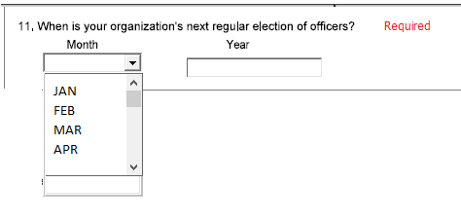
www.olms.dol.gov
Page 2– cont.
Items 10 - 11
Items 10 and 11- all fields are required for all union types.
County and State fields are swapped in the electronic form.
Item 10 - Based on the State selected, the County drop-down list will be filtered.
OLMS - EFS LM 1
Item 11 – Month will be a drop-down list.

Slide 15
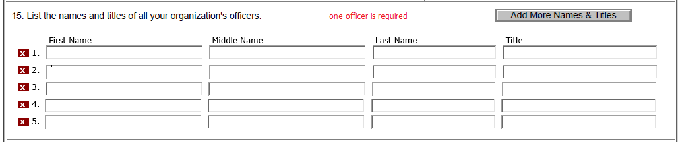
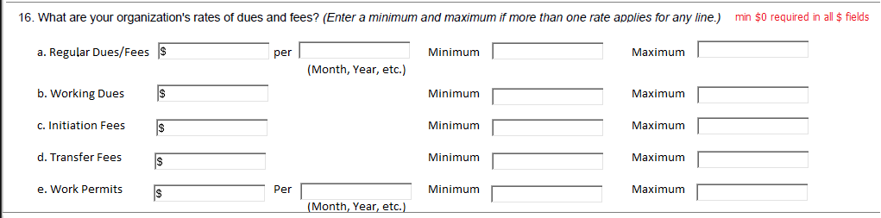
www.olms.dol.gov
Page 2 – cont.
Items 15-16
Item 15 – at least one officer entry is required for all union types.
Five grid lines will be listed by default.
More items can be added to the list.
OLMS - EFS LM 1
OLMS - EFS LM 1
Item 16 - minimum $0 is required in all amount fields.
The following fields will be non-negative integer fields. Minimum $0 needs to be entered in these fields.
a. Regular Dues/Fees , b. Working Dues , c. Initiation Fees, d. Transfer Fees , e. Work Permits
The following fields are associated with each item as listed in the mock-up below:
Per - Text field to enter the calendar basis for the payment. (e.g. month, year, etc.)
Minimum – Non-negative integer field to enter the minimum rate. This is not a required field.
Maximum – Non-negative integer field to enter the maximum rate. This is not a required field.

Slide 16
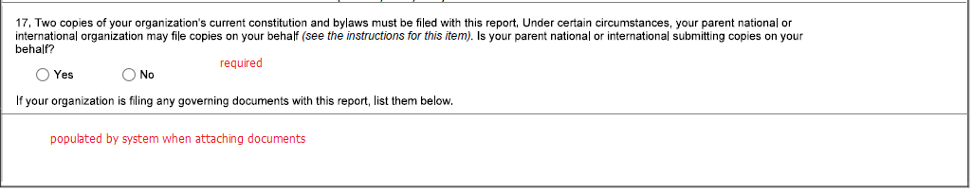
www.olms.dol.gov
Page 2– cont.
Items 17
Item 17 – The title for the field will be updated as follows:
OLMS - EFS LM 1
Either Yes or No is required to be selected in Item 17.
if Yes is checked in Item 17, no attachment is required.
if No is checked, the system will display a pop-up message indicating the bylaws must be attached.
If your organization is filing any governing documents with this report, list them below - This field will be disabled for data entry.
When the user attaches a file, this field will list the name of the file attached.
If no files attached, the field will be empty.

Slide 17
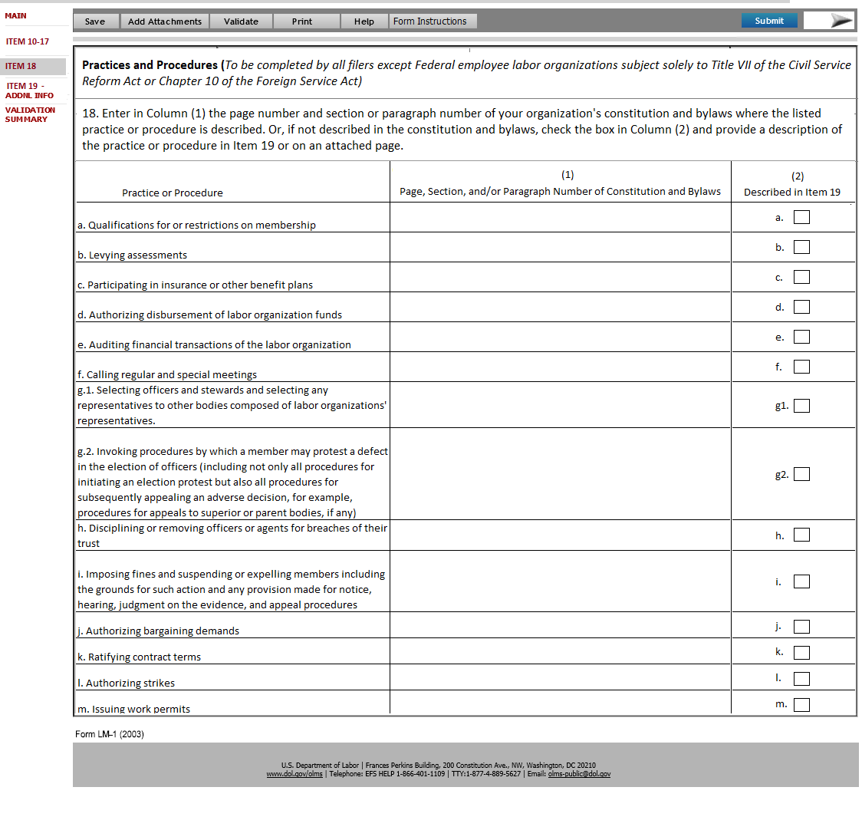
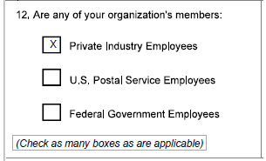
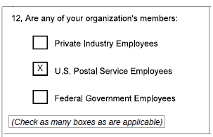
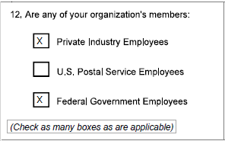
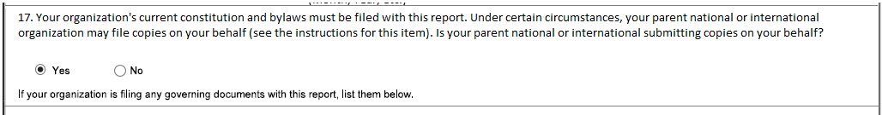
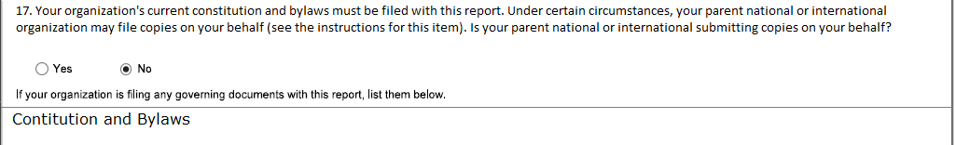
www.olms.dol.gov
Page 3
Data must be entered in either column (1) or check column (2).
Item 18 is required in the following cases:
If Private Industry Employees or U.S Postal Service Employees options are selected in Item 12.
If the Federal Government option along with other options are selected in Item 12. An example below:
OLMS - EFS LM 1
If Yes option is checked in Item 17
If No option is checked in Item 17 and if bylaws are attached

Slide 18
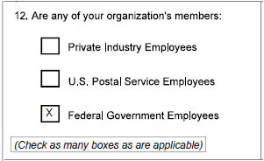
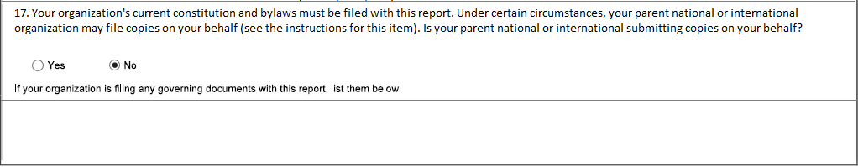
www.olms.dol.gov
Page 3 – cont.
Item 18 is not required in the following cases:
If only the Federal Government option is selected in Item 12.
If the No option is checked in Item 17 and if no bylaws are attached.
OLMS - EFS LM 1

Slide 19
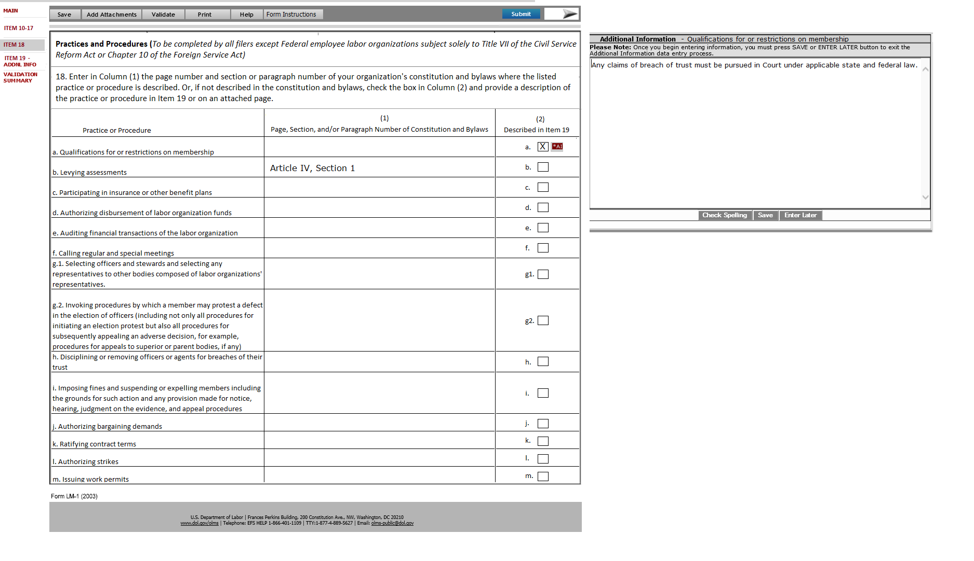
www.olms.dol.gov
Page 3 – cont.
OLMS - EFS LM 1
Each item checked in Item 18 - column 2, will have a separate Additional Information page created.
The data entered in each Additional Information page will be displayed in the ITEM 19-ADDNL INFO page.

Slide 20
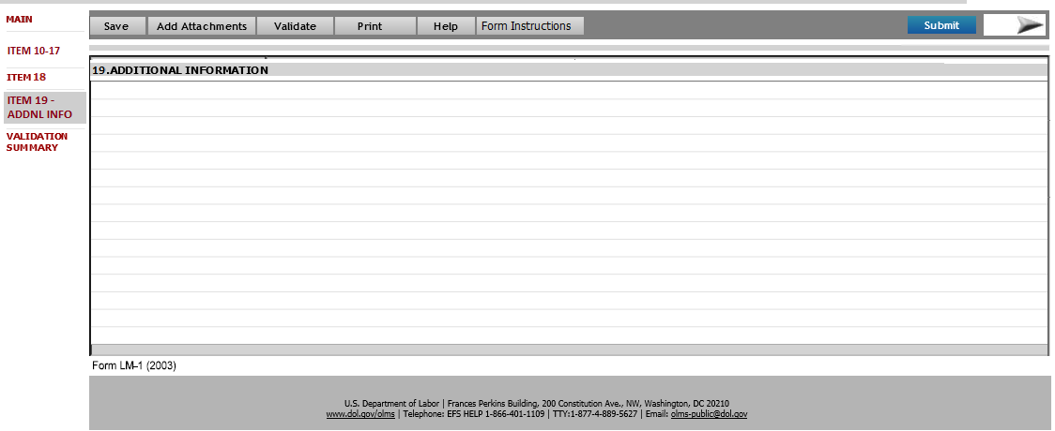
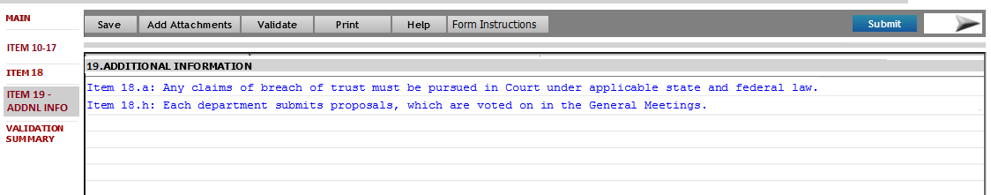
www.olms.dol.gov
Page 4
OLMS - EFS LM 1
This page will list all additional information entered in the report.
The filers may enter additional information against multiple items listed in page 3 – Item 18.
Additional information attached to each item will be identified using the same item number listed in Item 18.
The filer will use this page to review all the additional information entered in the report.
Each listing will have a navigation link enabled, clicking the link will navigate the filer to the corresponding AI page.
To modify the text, the filer will have to use the corresponding AI page

Slide 21
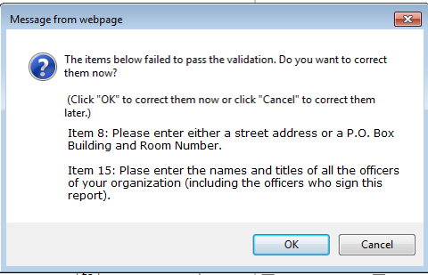
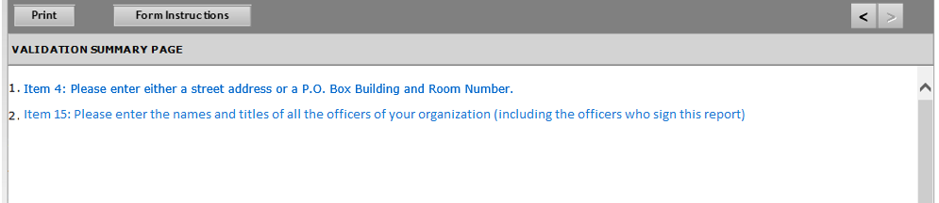
www.olms.dol.gov
Validation Summary
To sign and submit, the filer is required to successfully validate the form once the data entry is completed.
Any items failed during the validation will be displayed as a pop-up and in the validation summary page.
OLMS - EFS LM 1

Slide 22
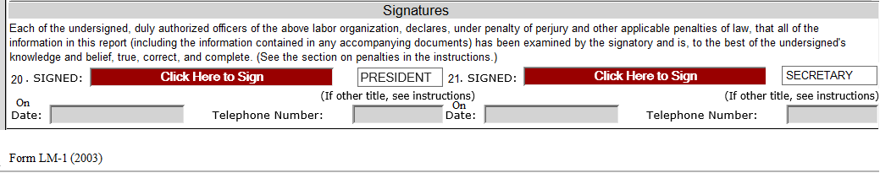
www.olms.dol.gov
Signatures
Once the validation of the form is completed and passed, the signature fields will be enabled.
OLMS - EFS LM 1

Slide 23
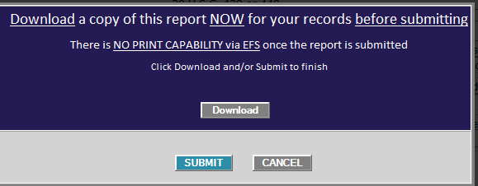
www.olms.dol.gov
Print and submit
Once the second signature is captured, the system will display the following pop-up message.
The filer may print the report at this time and may also proceed with submitting the report.
OLMS - EFS LM 1

Slide 24
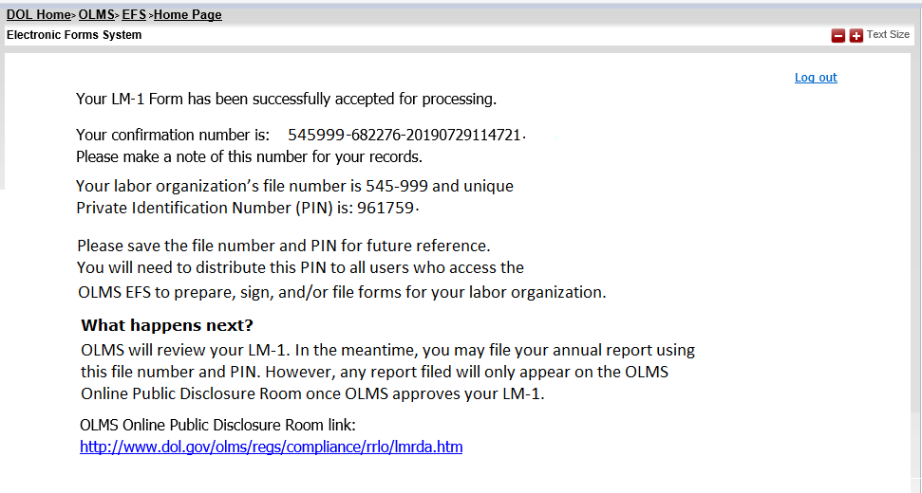
www.olms.dol.gov
Submit
Upon successfully submitting the report, a confirmation message will be displayed.
OLMS - EFS LM 1

Slide 25
www.olms.dol.gov
Submit
At this time, an email notification will be sent to all associated filers.
Thank you for completing the LM-1 report and registering with the Office of Labor-Management Standards (OLMS).
This email confirms your registration. Your labor organization’s file number is 545-999 and unique Private Identification Number (PIN) is: 961759
Each union is assigned a unique PIN as a way to securely allow only those persons who need to access the system to complete and submit a Form LM-2, LM-3, LM-4 or Simplified report Labor Organization Annual Report for your organization. To keep access limited, you must re-apply for your union’s PIN each year, as the current PIN will expire prior to the start of the next filing period.
Please save a copy of this email for future reference, as you will need to distribute this PIN to all users who access the OLMS EFS to prepare, sign, and/or file forms for your labor organization. To log into the EFS, all your users must enter this PIN, a valid user id and password, and the organization’s File Number.
If you did not register this labor organization and believe you have received this email in error, please contact OLMS at 1-866-401-1109.
OLMS - EFS LM 1

Slide 26
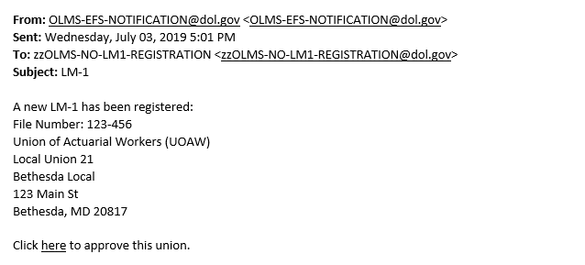
www.olms.dol.gov
Approval Process
Once the report is successfully submitted, the EFS system will generate an email to a new OLMS distribution group.
The email will provide a summary of the LM-1 submitted and a link to approve the submitted report.
OLMS - EFS LM 1
Once approved, the report will get published on the disclosure page.
Unions may use their file number before this approval process.
Unions will receive an email regarding the approval.
The report will be published on the disclosure page only after it is approved.

